Slide 1


Session 3: Beginning manual curation
Day 2
Genome Reference Informatics Team (GRIT)
Wellcome Sanger Institute - Tree of Life

Slide 2
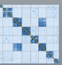
Overview
Analysis pipelines
Treeval
Curation pretext pipeline
Curation tools
Jbrowse
Rapid curation workflow (tomorrow)
How to produce a curated fasta file
How to use PretextView

Slide 3
JBrowse
Can I share the Pretext tutorial with them?
Follow the order in the tutorial
No slides, show live

Slide 4


TreeVal as an aid for curation
Jbrowse
Notes:
Hi I’m Jo and I am also a curator in the GRIT team.
As Dom mentioned, today I am just going to give you a quick introduction to the TreeVal browser which we use as an aid to curation for some of our genomes

Slide 5

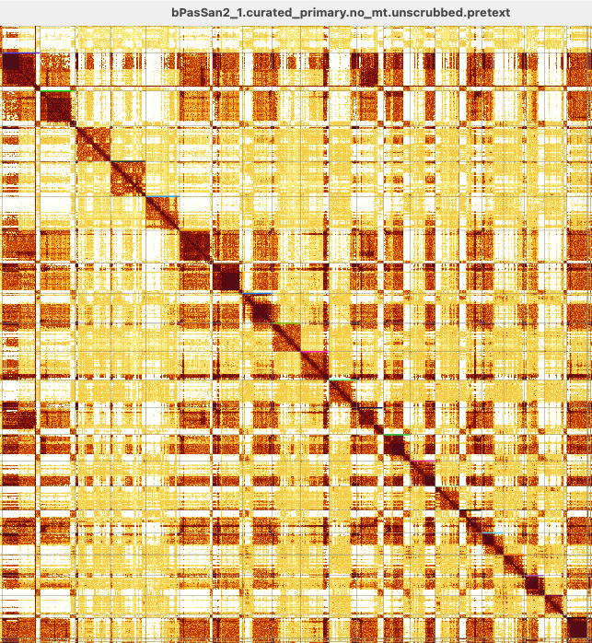


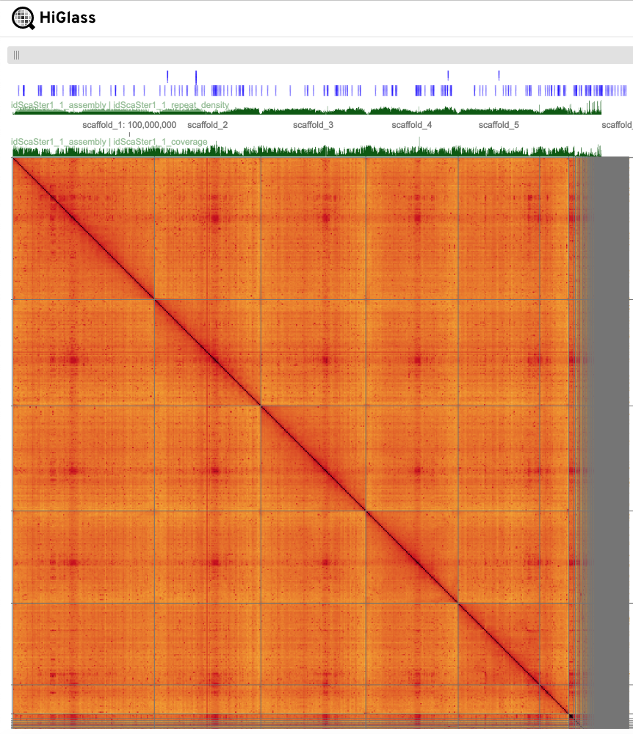
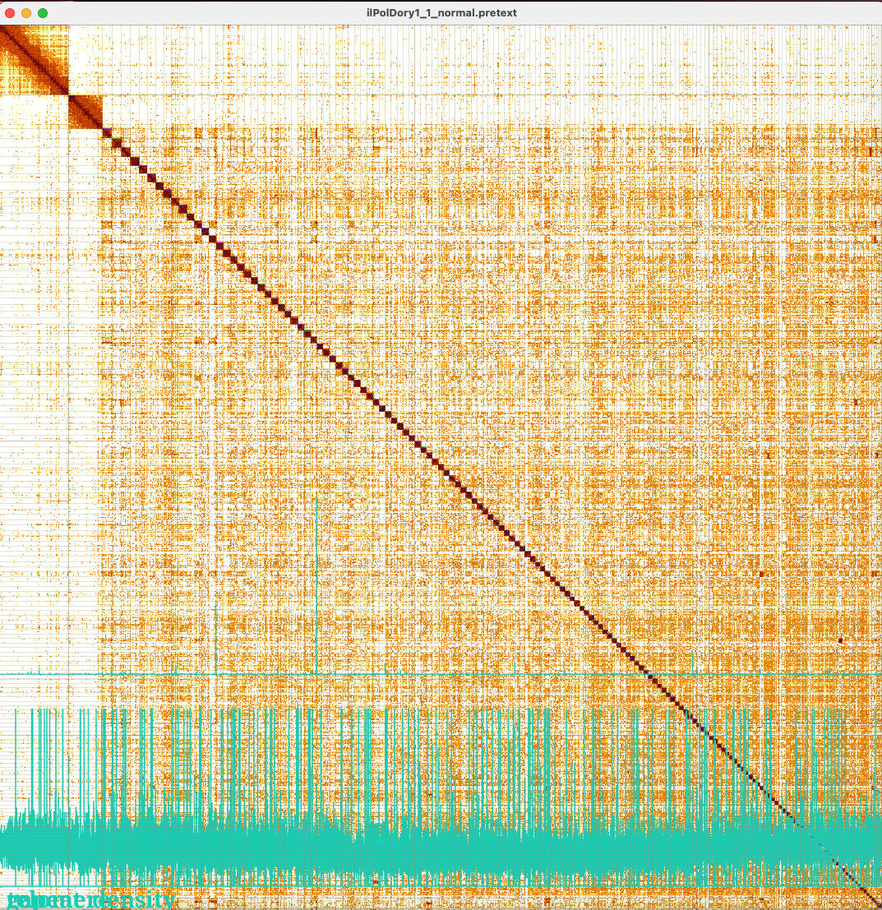
TreeVal Browser
All projects coming into the curation team now go through the TreeVal Pipeline (github.com/sanger-tol/treeval)
All draft assemblies
Might not be enough for curation
Evidence data for curation
e.g HiC maps, Coverage, telomere, repeat tracks, gene alignments
Problematic
species
TreeVal
Browser
In depth information is provided
By Jo Collins
Notes:
Hopefully some of you may have been able to attend the TreeVal pipeline workshop so will have already been introduced to the browser, for those who didn’t I will just give a very brief outline.
Within Tree of life all draft assemblies are now processed through TreeVal, this is a Nextflow pipeline which generates of all the data types required for manual curation - for example HiC maps with additional data tracks overlaid such as coverage and telomere, and other analysis such as gene alignments and synteny plots.
As a result of the continued improvement in the quality of both the raw data and the auto assembly process the majority of our assemblies can be resolved using just the HIC maps decorated with additional data tracks
However, there are some genomes which have certain characteristics where just having the HIC maps does not provide us with enough information to reach our goal of producing fully chromosomally resolved assemblies. Examples of this are species such as birds and sharks who possess microchromosomes which can be as small as 150kb in length. Because of their small size they are very difficult to identify and assemble using HiC data alone as at this size there is a very low level of granularity within the map and often we see cross linking between signal where these separate chromosomes have common repeat elements.
It is for these trickier assemblies whom require a more in-depth assessment that a TreeVal browser is produced in addition to the HiC maps.
As standard, a browser is also produced for Family representatives of each order – just to add another layer of detail should that family turn out to be a particularly difficult group to curate.
Within Darwin Tree of Life we are utilising Jbrowse to better interrogate certain assemblies which are not entirety resolvable using HiC maps alone
Some assemblies have particular characteristics which hinder efforts to achieve our goal of producing fully chromosomally resolved genomes
For these assemblies explicit benefits are provided by the alignment of additional data sets to the standard as facilitated by Jbrowse.
As a result of the rapid development in sequence data quality and assembly processes the assemblies coming through the pipeline are typically of increasingly good quality with less errors/gaps that with older assemblies, as such much of the curation is done using only the HiC maps
Some assemblies however have particular characteristics which can mean that they are not fully resolvable using HiC alone – for each of these assemblies a Jbrowse instance is created so that additional data may be laid over the assembly to help with curation

Slide 6
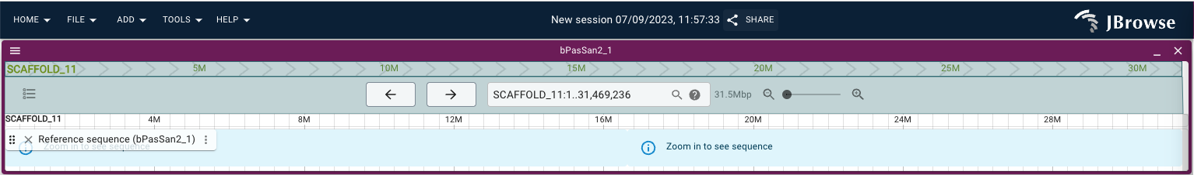
TreeVal Browser
Why Jbrowse?
Jbrowse provides the perfect platform for visualisation of assemblies:
Simple to use, web-based, lightweight, interactive and scalable
It’s an extensible platform that utilizes multiple data types in a variety of genomic data formats such as FASTA, VCF, BAM, BED/BIGBED, HIC, CRAM, PAF and GFF3
Highly customisable
https://jbrowse.org/jb2/
Notes:
The browser of choice selected by the assembly group to host the TreeVal datasets is Jbrowse
This provides the perfect platform for visualizing and integrating biological data because it’s very simple to install, web-based and lightweight. Its also highly interactive and scalable.
Additionally, It’s a vastly extensible platform that hosts a whole array of different files types and is customizable with a number of existing plugins.

Slide 7
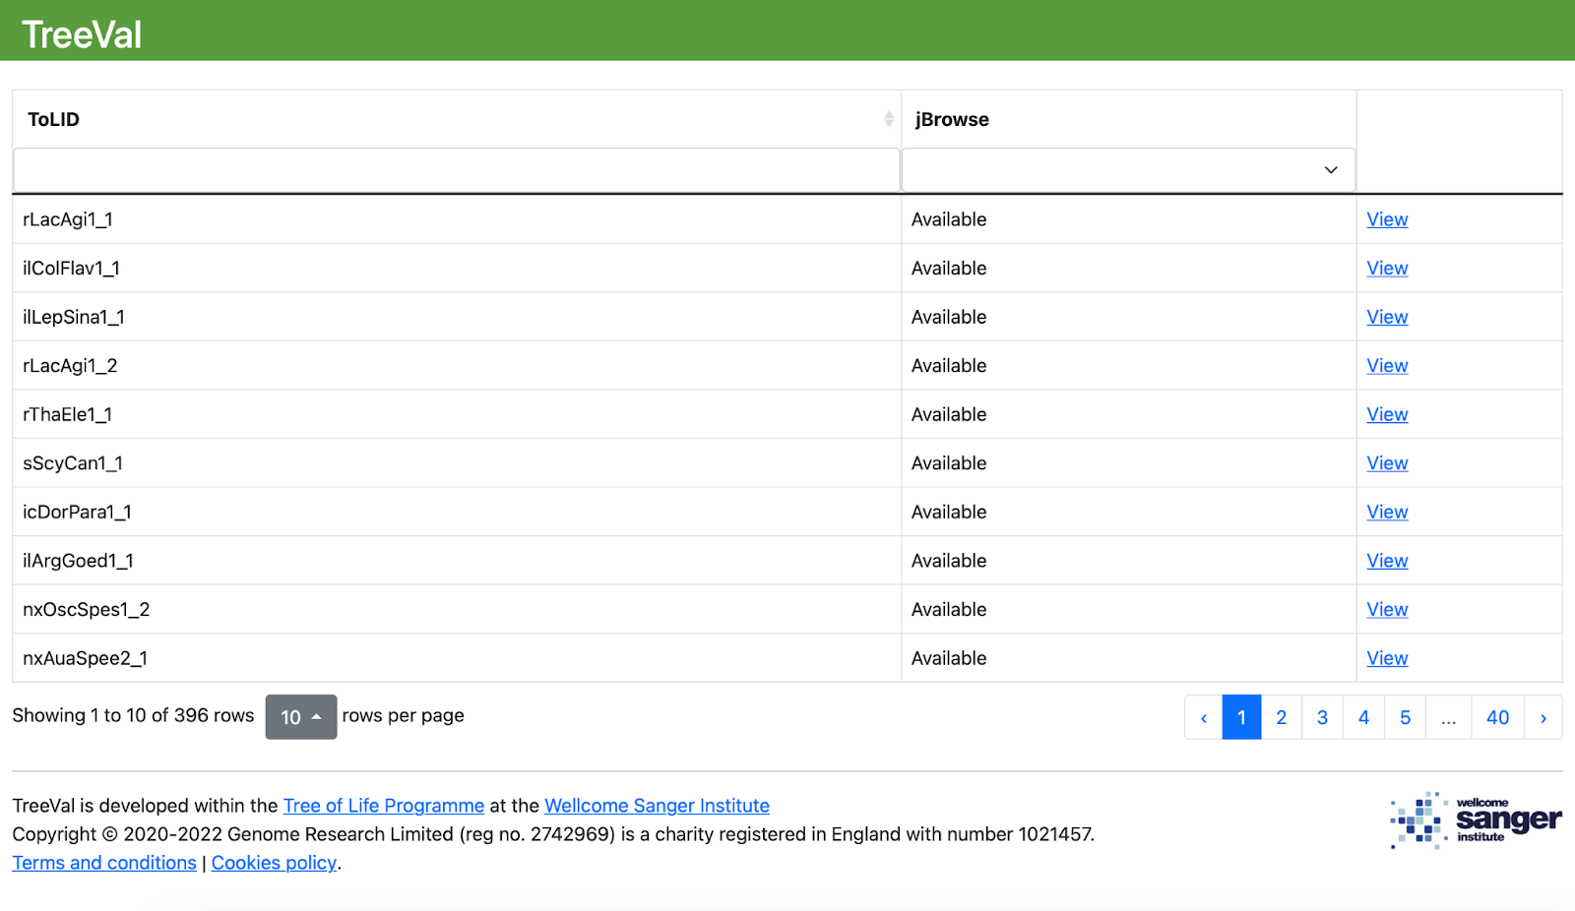
How to start using TreeVal (Jbrowse)?
http://jbrowse.tol.sanger.ac.uk
Type your TOLID here

Slide 8
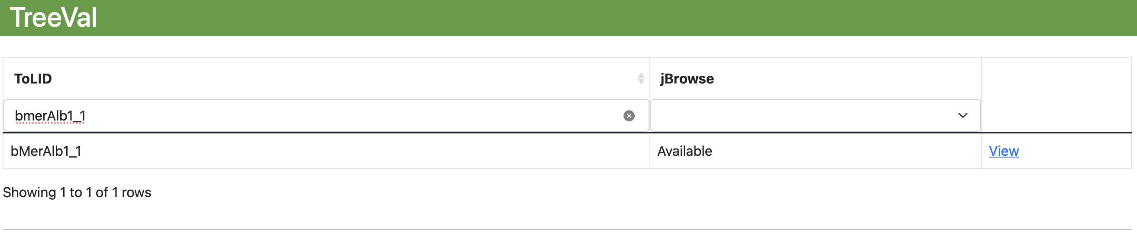
How to start using TreeVal?

Slide 9
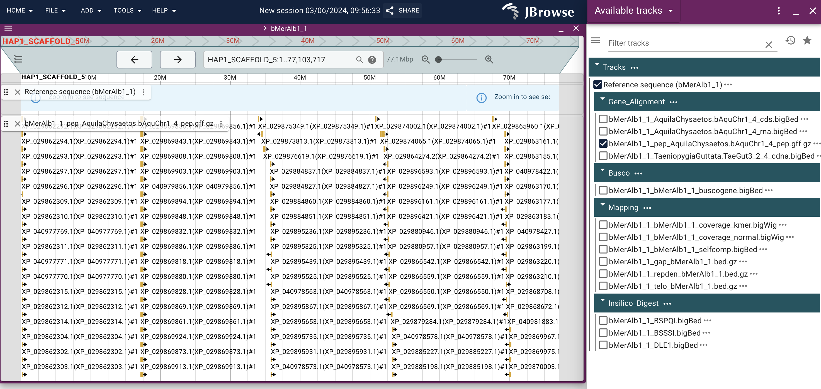
How to start using TreeVal?
Click to see available tracks
Click or type to select scaffold
Click to zoom in/out
Proteins in the alignment

Slide 10
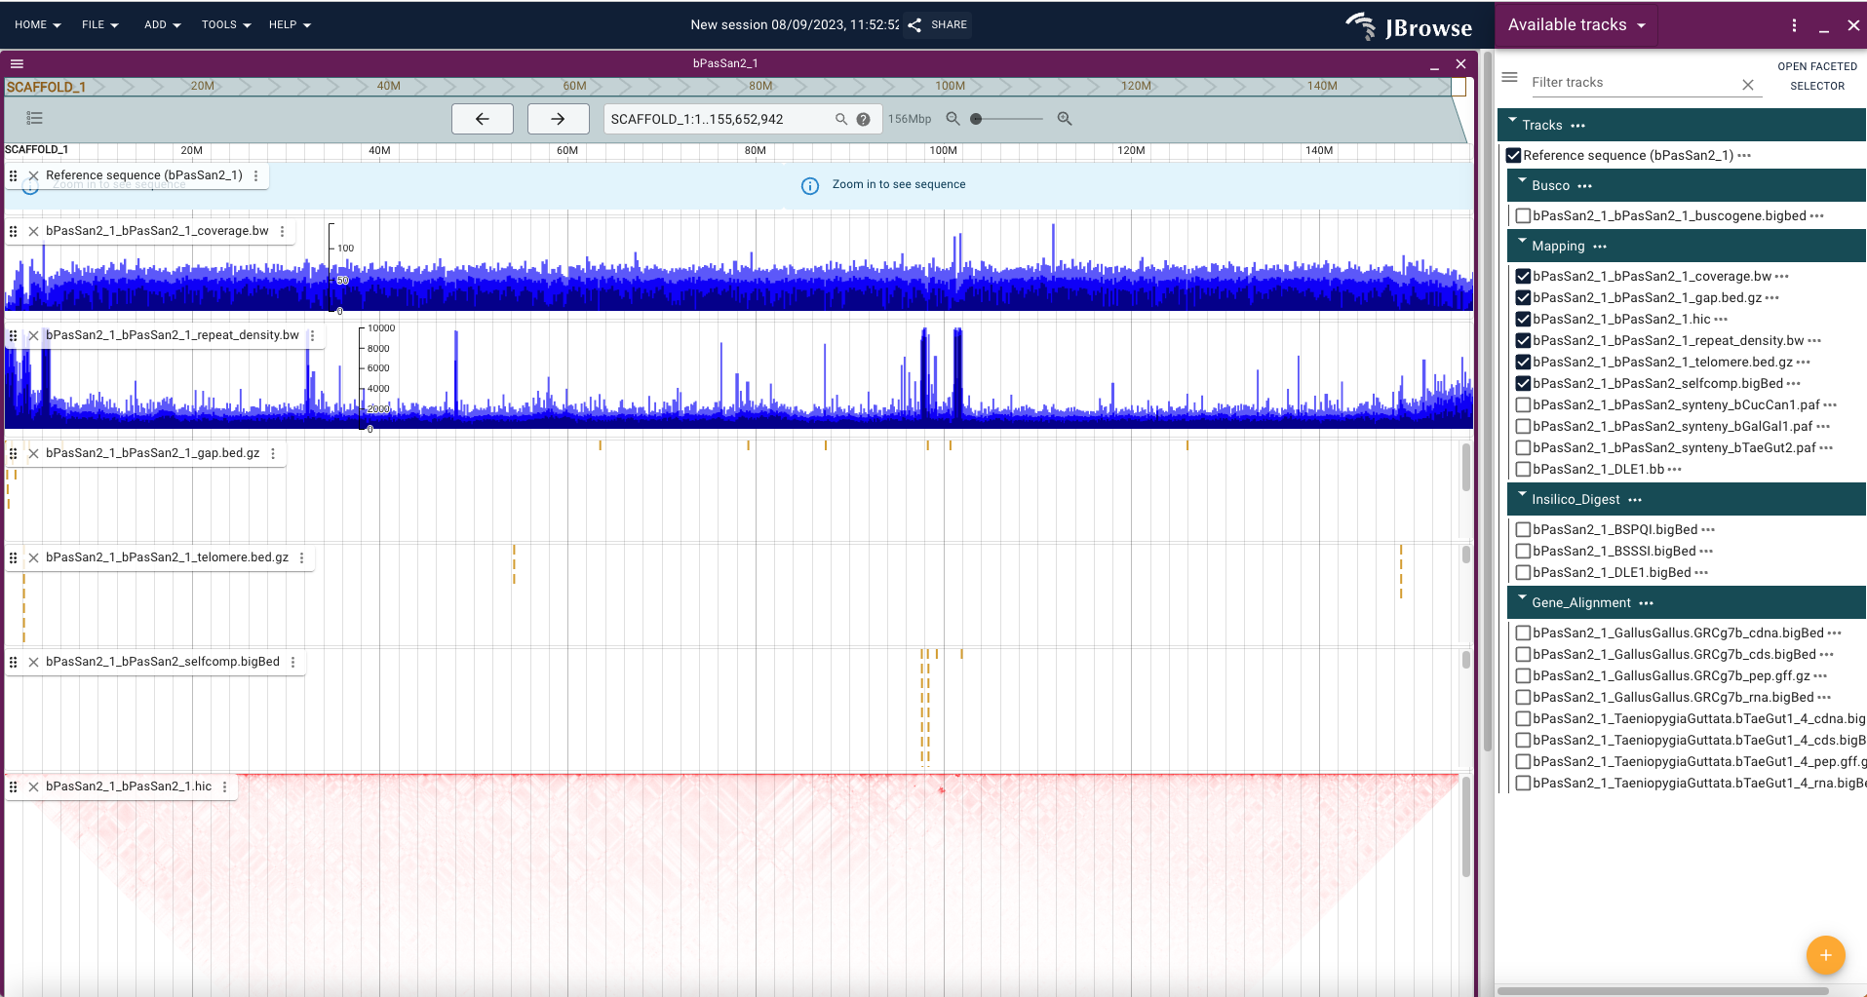
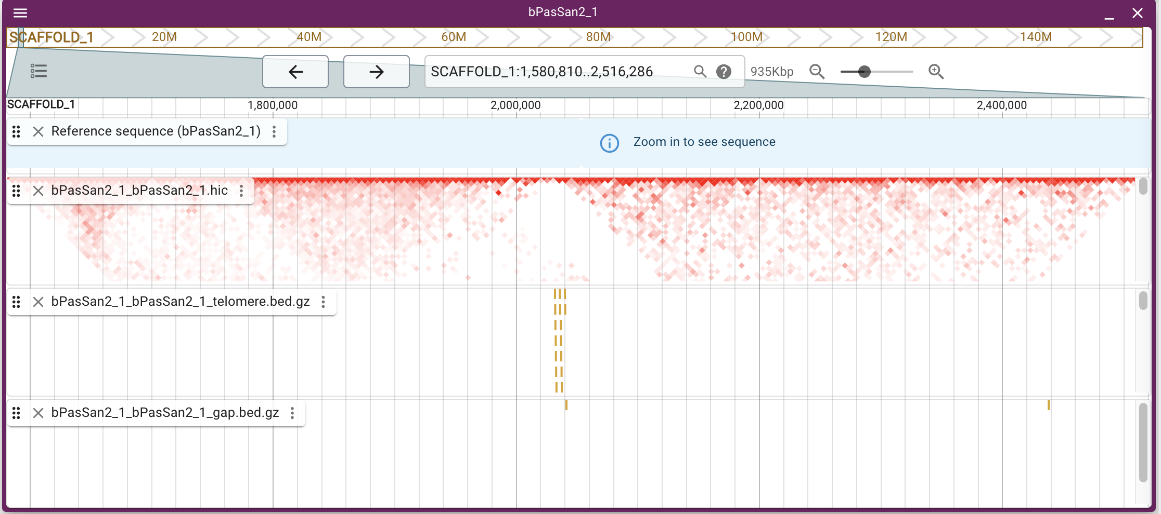
Which data types do we align to our assemblies?
Coverage
Repeat Density
Gap
Telomere
Break in HiC continuity
Internal Telomere sequence
Seq gap
Selfcomp
HiC
Notes:
now lets take a look at the data types that are aligned to the assemblies
So starting from the top track we have the coverage plot – this can be useful for identifying regions of haplotypic duplication where you would expect to see the coverage at half for regions that are artificially duplicated within the assembly. We can also use coverage to assess if a region looks collapsed, for example if it is repetitive. As explained by Dom we also use coverage data to identify sex chromosomes in heterogametic assemblies.
Next we have the repeat density track. This data provides an indication of low complexity and global repeat density at a given position throughout the genome, this can be useful when assessing the quality of the assembly of entire scaffolds or of regions within scaffolds that could be misassembled.
Then we have the gap track – it’s always useful to see where gaps in the assemblies lie as this is where the contigs are joined during the scaffolding process and is often where errors may be introduced.
Next down is the telomere track, we screen our assemblies to identify candidate telomere sequences using kmers which occur multiple times close to scaffold ends, these are marked up and provide useful information for confirming assembly fidelity. Although these can at times be misleading as some species have intrascaffold telomere sequences as a result of fusions of ancestral chromosomes as can be seen in this bird. Also some species do not have a defined telomere motif e.g Diptera and hymenoptera.
We now come to the self comp track - selfcomp is mummer based analysis of the assembly aligned to itself. The blocks highlight regions where the sequence is repeated elsewhere in the genome. It is another tool that can be useful in confirming haplotypic duplication but it can also indicate assembly errors and joins.
Finally the last track on this slide is the HiC data. Unfortunately, this track cannot provide us with inter-scaffold information, but it can help to confirm or dispute the integrity of the scaffold displayed - particularly when used alongside the other evidence tracks. For example, in this region we can see that the break in continuity in the hic data is also in the same location as a gap and internal telomere sequence which indicates that there is likely to be a misassembly at this point.

Slide 11
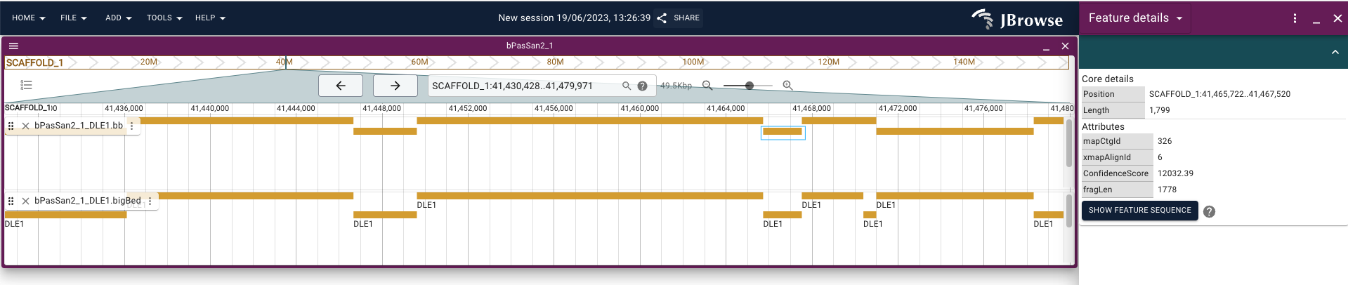
Optical mapping data
Bionano mapping fragments can be aligned to the underlying assembly
These maps can be directly compared with an insilco digest of the assembly
Concordance between map types confirms the assembly whereas discordance may indicate misassembly
Bionano mapping fragments
Insilico digest of assembly
Notes:
For some of our assemblies Bionano optical mapping data is available.
The bionano mapping fragments are aligned to the assembly, as a single track.
A separate track is then loaded that displays an in silico digest of the underlaying data. Concordance between map types – as can be seen in this image- serves to confirm the assembly over a region - whereas discordance may indicate misassembly.

Slide 12
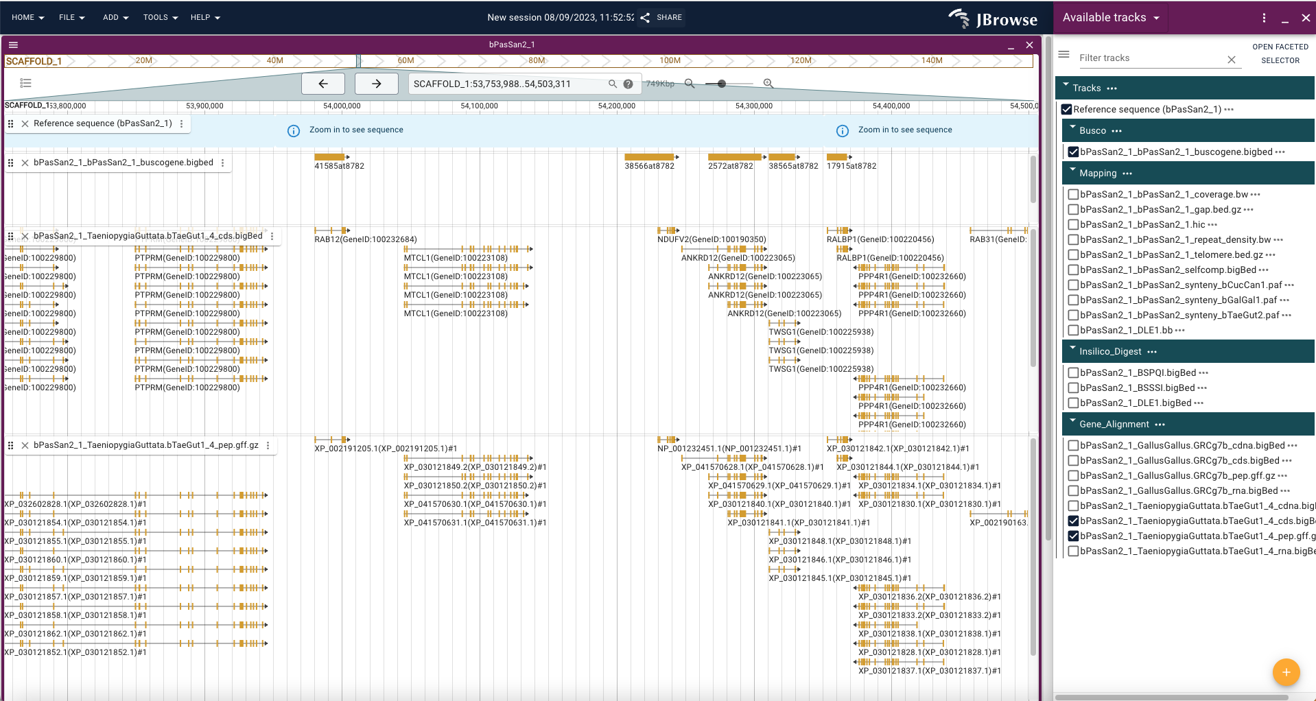
Gene alignment data
BUSCO
CDS
Peptide
Notes:
We assess all of our assemblies for BUSCO completeness, and for those with a Jbrowse instance we also display the mappings as a track. Clicking on an entry provides a link to the record held in orthodb, from here, if required, you can then link to the related gene and find its chromosomal location on close comparators which might be useful for example when trying to identify Sex chromosomes in homogametic samples.
CDS, RNA and other alignments are available, where possible these are from species closely related to the underlying assembly. However due to the nature of the work we are undertaking sometimes it is not possible to find data from a close relative. In these circumstances we have found that peptide alignments can prove very useful
Scrutiny of gene mappings can be useful for curators in several circumstances. High quality mappings split between scaffolds can provide good evidence for scaffold joins, and they can also also point to misassembly.
Identification of good quality gene hits is also an extremely useful tool in aiding our attempts at locating and assembling the tiny scaffolds that make up microchromosomes. This is because we have observed in numerous assemblies that the euchromatic portions of these chromosomes are shattered, and, as already mentioned they often interact with each other and with repetitive scaffolds making them very tricky to identify and assemble with any certainty using HiC alone.

Slide 13
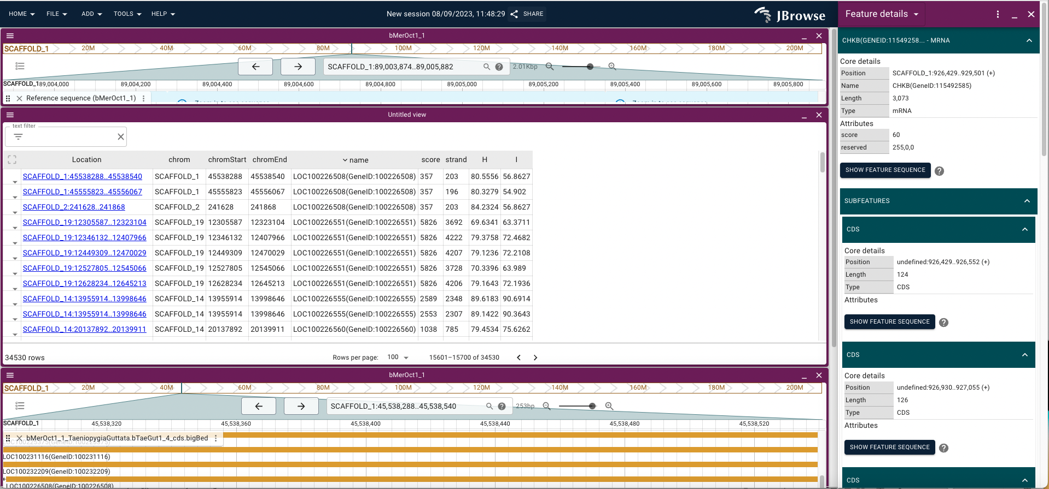
Punchlists
Notes:
For each assembly within Jbrowse a set of punchlists are produced for the various transcript mappings. The Punchlists are automatically generated lists of regions of interest, specifically they report genes, peptides etc that have multiple hits within the assembly.
The punchlists are in bed file format, and can be uploaded directly to the browser via a url, where they are then displayed in a spreadsheet format
In this example using the cds punchlist we can see that we have mappings for individual genes on multiple scaffolds. These could be repetitive hits or these multiple mappings could be split genes potentially indicating a missed join, or a misassembly.
It is possible to search for specific regions or genes of interest using the text filter. The TreeVal group are in talks with the JBrowse developers to have these punchlists ingested alongside the other tracks rather than having to load them separately each time.
Although currently we only use punchlists to display split transcripts they could be used to navigate directly to other regions of interest for example gaps and telomere mappings

Slide 14
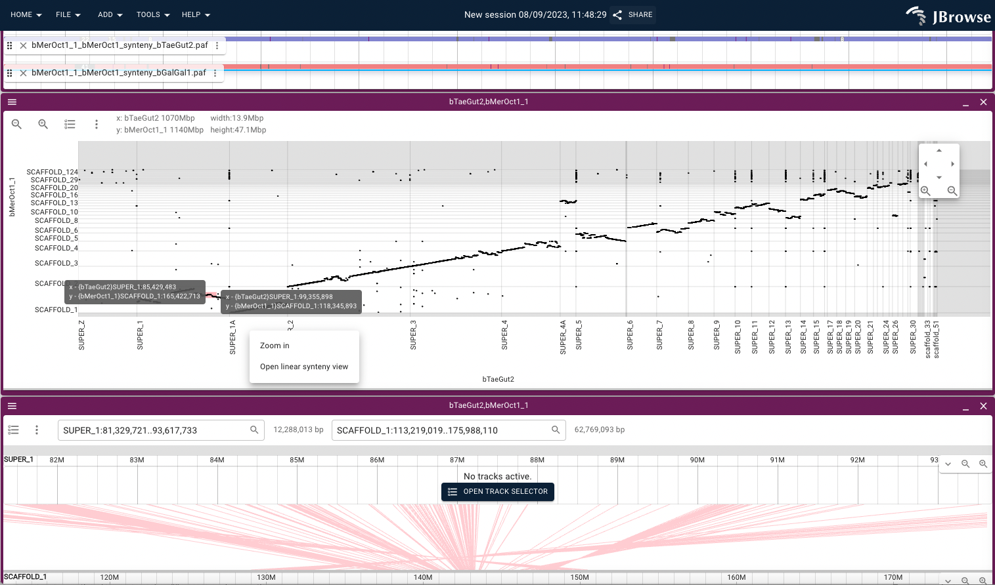
Synteny data
Notes:
Synteny tracks are available, currently this is primarily for birds where we have a good set of comparator assemblies, going forward synteny tracks will be included for other species where appropriate.
This data can be useful for investigating potential misassemblies, for example between query assembly and comparator, between different iterations of the same assembly, and also when you are curating the whole genome and you want to investigate differences between both haplotypes.
A great feature in JBrowse is the ability to generate a dotplot of your assembly against the comparators for which synteny alignments have been produced. This saves you the time of generating additional dotplots and can be useful for providing a quick indication of possible misassemblies in your data, helping to identify and pull together scaffolds which make up mircochromosomes and also for providing naming and orientation information if you are assigning chromosomes with respect to an existing reference.
The plot is interactive in that you can zoom in on a region and scroll around the map. You can also directly open a synteny view from the plot enabling closer scrutiny of your region of interest

Slide 15
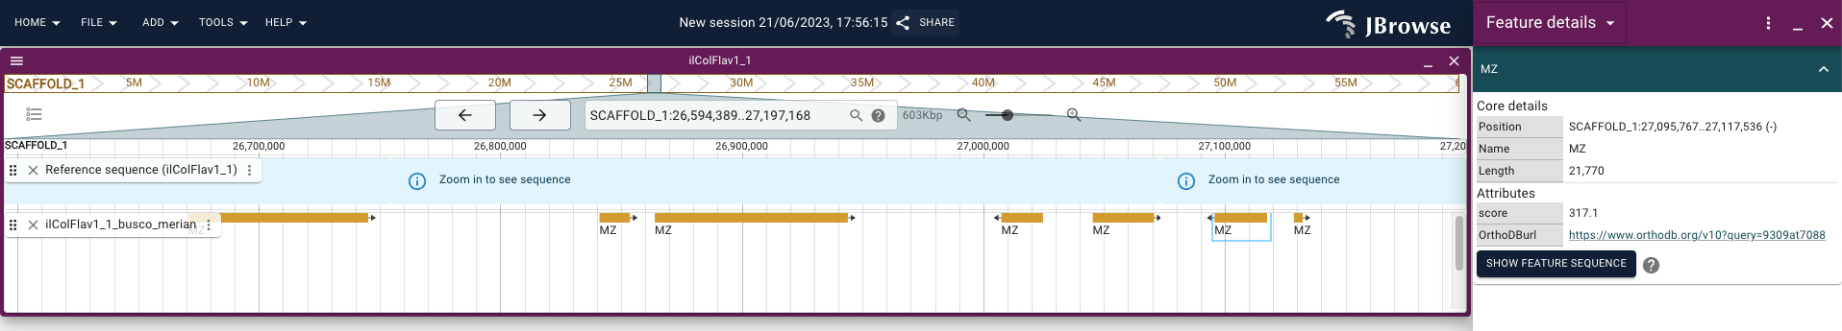
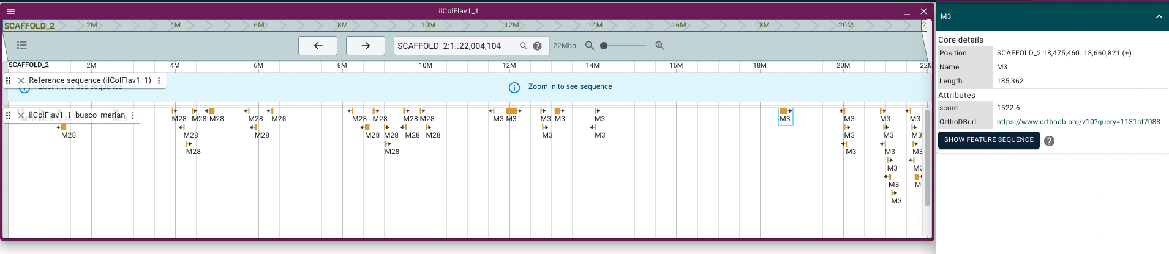
Chromosome painting
Merian unit mappings to MZ indicate this scaffold is the Z chromosome – highly conserved in leps
Mappings to Merian unit 28
Mappings to Merian unit 3
Merian unit mappings indicate potential misassembly or fusion
Notes:
The final feature that I wanted to highlight is the ability of the browser to display chromosome painting as a track. At present this has just been added for lepidoptera where the ancestral linkage groups – or Merian elements - are mapped to the underlying assembly. This is useful for a couple of reasons. For example in the top image we can easily identify which scaffold is our Z chromosome this speeds up curation time as we don’t need to run separate alignments against comparators. In the case of this assembly we can trust this data as the Z chromosome is highly conserved in leps.
In addition, in our second image where we can see mappings from 2 different Merian units we are immediately alerted to either a possible misassembly within the region – which can then be further investigated by using the additional tracks and HIC data, or we are looking at an autosome fusion which although not significant for curation purposes is of interest to downstream users.

Slide 16
Future development and improvement
Markers and Linkage maps:
Useful for sex chromosome identification
Ancestral unit markers:
e.g. Nigon units for Nematodes, Muller elements in Drosophila
Centromeric repeat track :
GRIT curators to work with assembly group to identify candidate centromeric sequences
Implementation of further plugins:
e.g. Circos plots to show comparative relationships
Jbrowse for curated assemblies:
Curated assemblies could be uploaded for downstream users
Additional plugins could be implemented for other available data sets
Notes:
Having gone through the data that is available on the current release I just wanted to mention some future developments and improvements that the TreeVal group are looking to implement
First they are looking to add Marker and linkage maps – which will be helpful particularly with regard to sex chromosome identification.
Also further ancestral unit makers such as the Nigon units for Nematodes and Muller elements for Drosophila
The curators and assembly group will work together to try and identify candidate centromeric sequences to help direct curation in fragmented genomes
Where appropriate we will look to implement additional plugins for our precuration data that add further layers of evidence to support our curation decisions for example it would be really useful for assembly comparison if a circos type plot plugin became available
The final point I wanted to mention is the potential use of the TreeVal browser to interrogate curated assemblies.
Finalized genomes could be uploaded, and using the existing pipeline additional data sets can then be aligned for analysis purposes. Depending on the use case further plugins could also be implemented to display even more data types.
We think this could provide a great resource for fast genome analysis that is independent of release cycles for the main genome browser sites such as Ensembl and UCSC.

Slide 17
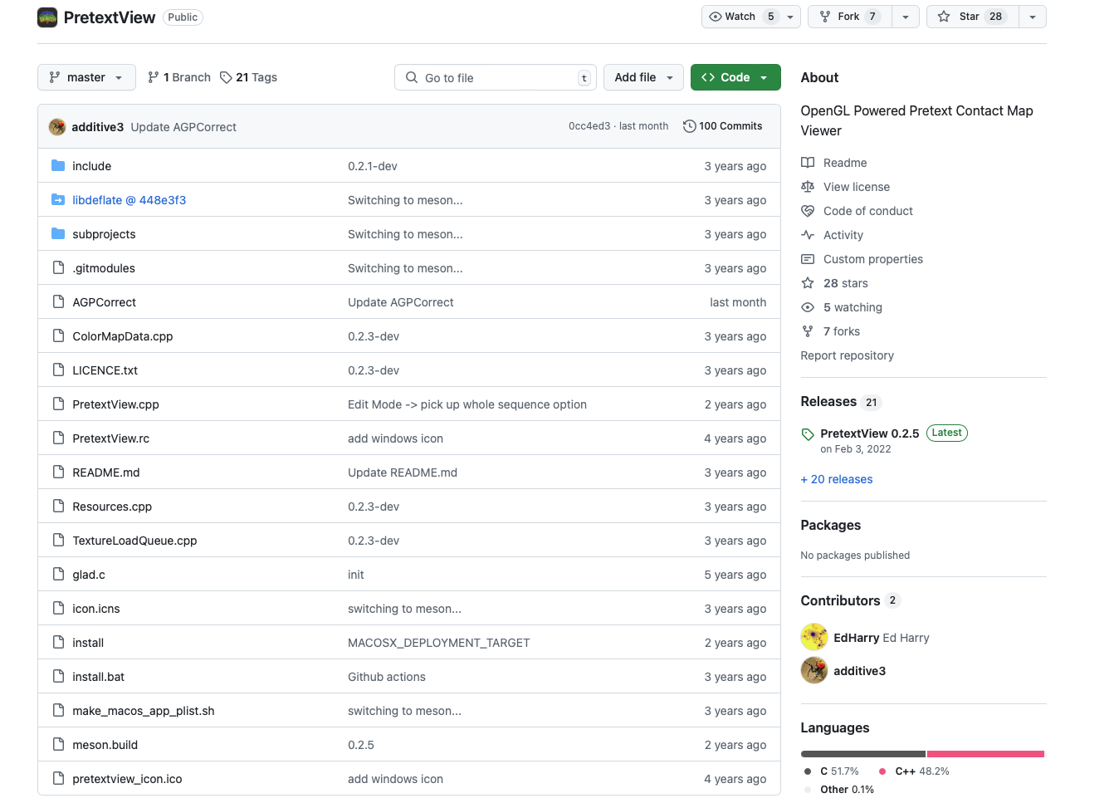
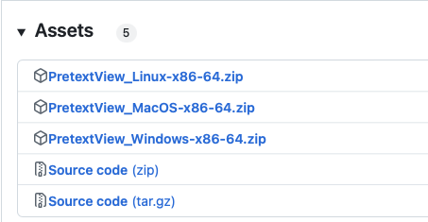
How to use PretextView
Download PretextView from: https://github.com/sanger-tol/PretextView

Slide 18
How to use PretextView
Click ‘Load Map’ and open a map
Keyboard Shortcuts
Press ‘U’ to open menu
Press ‘E’ to enter the Edit mode and make edits
Press ‘Q’ to undo an edit
Press ‘W’ to redo an edit
Click middle button to flip (invert) a scaffold
Press ‘S’ to enter the Scaffold mode: Paint scaffolds blocks as chroms
Click middle button to delete painting
Press ‘A’ to paint a block of scaffolds at once
Press Shift + ‘D’ to delete all the painting in the map

Slide 19
How to use PretextView
Press ‘M’ to enter Metadata Tag mode: add tags such as haplotigs, unloc, HAP1, HAP2, X, Z, Contaminant…
Use arrow keys in your keyboard to select the active tag
Press Shift + ‘D’ to delete all tags in your map
Press ‘I’ to show ID bars: delimit and show orientation of the scaffolds
Press ‘G’ to switch the grids on and off
Press ‘B’ to show scale bars at the top
Press ‘T’ to switch the tool tip on and off: show coordinates in the map and info about active tracks
Arrow keys left/right: adjust contrast
Arrow keys up/down: change color scheme in the map
Press ‘W’ to enter Waypoint edit mode: mark specific regions

